Slide 1
Informational Policy Improves Consumers’ Choice for Healthier Food
Norman Lo and Anoshua Chaudhuri
Department of Economics, San Francisco State University

Slide 2


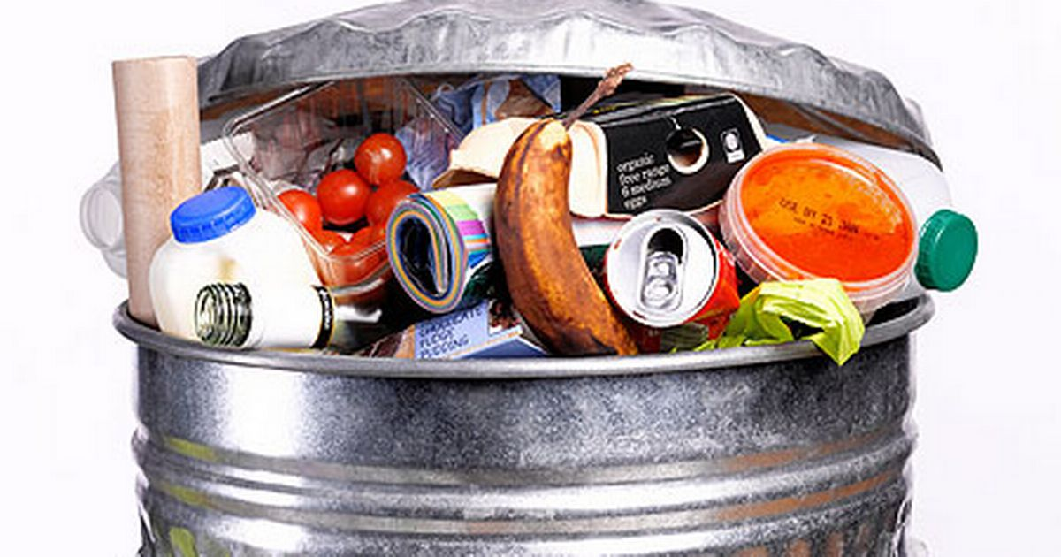
Initiative
Family and friends around me …
Overconsuming & excess food waste …
Can it be explained and solved by economic theories?
Notes:
Concern of the health condition of my family and friends.
Even worst, throwing away 1/3 of the food production in the U.S.

Slide 3
Research Question
Effectiveness of informational policies
Effect of the Nutrition Labeling and Education Act (NLEA)?
Does education matter?
Does effect of reading labels vary across different education groups?
Impact of NLEA on different ethnic groups
Why some ethnic group benefit more from the NLEA regulation?
Notes:
Effectiveness of informational policies – effect of nutrition labeling, health education, and health information on consumer dietary habits for addressing the obesity epidemic in the U.S.
Immediate Effect of NLEA – Do we observe an immediate effect of the NLEA?
Education Attainment Group – Was there any evidence suggesting the NLEA has different impacts on different education attainment groups?
Ethnic Group – Were different ethnic groups adopt the NLEA regulation equally?

Slide 4
Summary of Findings
Informational policies is an effective policy tool, but it takes time.
Higher education, on average, has a significant reduction on BMI, if they make use of nutrition labels.
In general, we do not find any evidence that those with high school or less benefit from the nutrition labeling law.
Non-Hispanic whites seem to have adopted the NLEA regulation faster compared to other ethnic groups.
Notes:
We find the Nutrition Labeling and Education Act had minimum or no significant effect on improving health outcomes at the early stage of enforcement.
It took time for the general population to adopt the available information in order to adjust their dietary habit.
We find a significant reduction in BMI for consumers with college education, who often make use of nutrition label at the point of sales.
Compare to lower education attainment group (high school graduate or lower), higher education attainment group (some college education) benefited the most from reading the nutrition label.
In general, white population had better adopted the NLEA regulation versus other ethnic groups. One possible explanation is that they are the major consumer of pre-packaged food.

Slide 5
Nutrition Labelling: Why should it matter?
Nutrition Labeling and Education Act 1990
(Exemption for small businesses and foreign firms until 1995)
Provision:
Food safety
Product differentiation (food quality)
Minimize the imperfect information of the product
Market price that reflects true costs (level of risk) and benefits enjoyed by the society
Notes:
Talk about NLEA

Slide 6
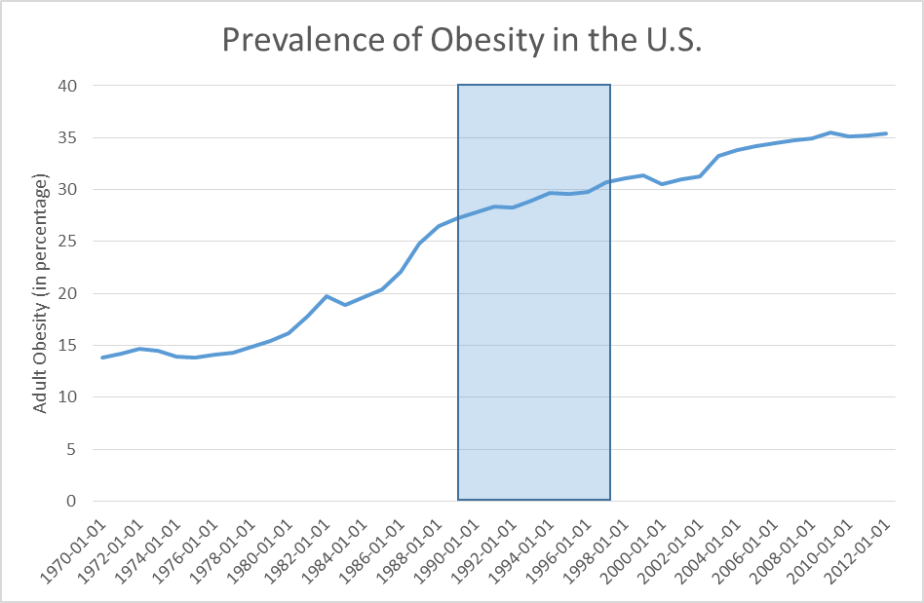
Obesity Epidemic
Notes:
By the National Health and Nutrition Examination Surveys (NHANES), the obesity rate has been increasing since 1970.
NHANES I (1970-1974) / NHANES II (1976-1980) / NHANES II (1988-1994) / NHANES (1999-2010)
The rate of increase has declined in the most recent years.
It’s a complicated social problem in the U.S. and we are trying to explain how the informational policy can be a solution to the U.S. obesity epidemics.

Slide 7
Literature Review
Attribution of obesity epidemic
Sweetened beverages
Food accessibility and availability
Fast food
Farm policies (farm subsidies)
Strenuous work & Exercise
Effectiveness of nutrition labeling
Improves the quality of food product (Caswell and Mojduszka, 2014)
Consistently links with healthier diets (Campos, et al, 2001)
Reduces consumption on certain nutrient and more likely meeting the dietary guidelines (Kim et al, 2000)
Notes:
Sweetened beverages, Blair and Sobal (2004), HFCS lower cost for sweetened food products, more accessible.
Food accessibility and availability, Jekanowski et al., (2001), increasing the supply of convenience, especially for food-away-from home.
Fast food, Cutler et al., (2003), prevalence of fast food lower the time cost for food consumption, especially food away from home.
Farm policies, Alston et al., (2008), modest and mixed effects on ingredients in more-fattening foods.
Quality of food product, Caswell and Mojduszka (2014)
Healthier diet, Campos et al., (2011)
Meeting dietary guidelines, Kim et at., (2000)

Slide 8
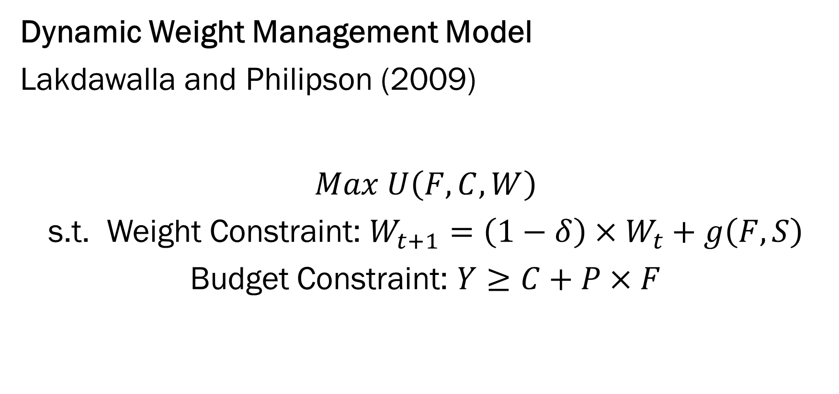
Theoretical Model
Dynamic Weight Management Model
Lakdawalla and Philipson (2009)
$$Max U\left(F, C, W\right)$$
s.t. Weight Constraint: $W_{t+1}=\left(1−δ\right)×W_{t}+g\left(F,S\right)$
Budget Constraint: $Y≥C+P×F$
Notes:
Model Prediction:
Agricultural technology expansion causes fall in relative food prices
The cause of obesity growth is due to the increase in the relative demand for calorically dense food
The positive effect of earned income on weight reinforce the price effect and raise weight

Slide 9
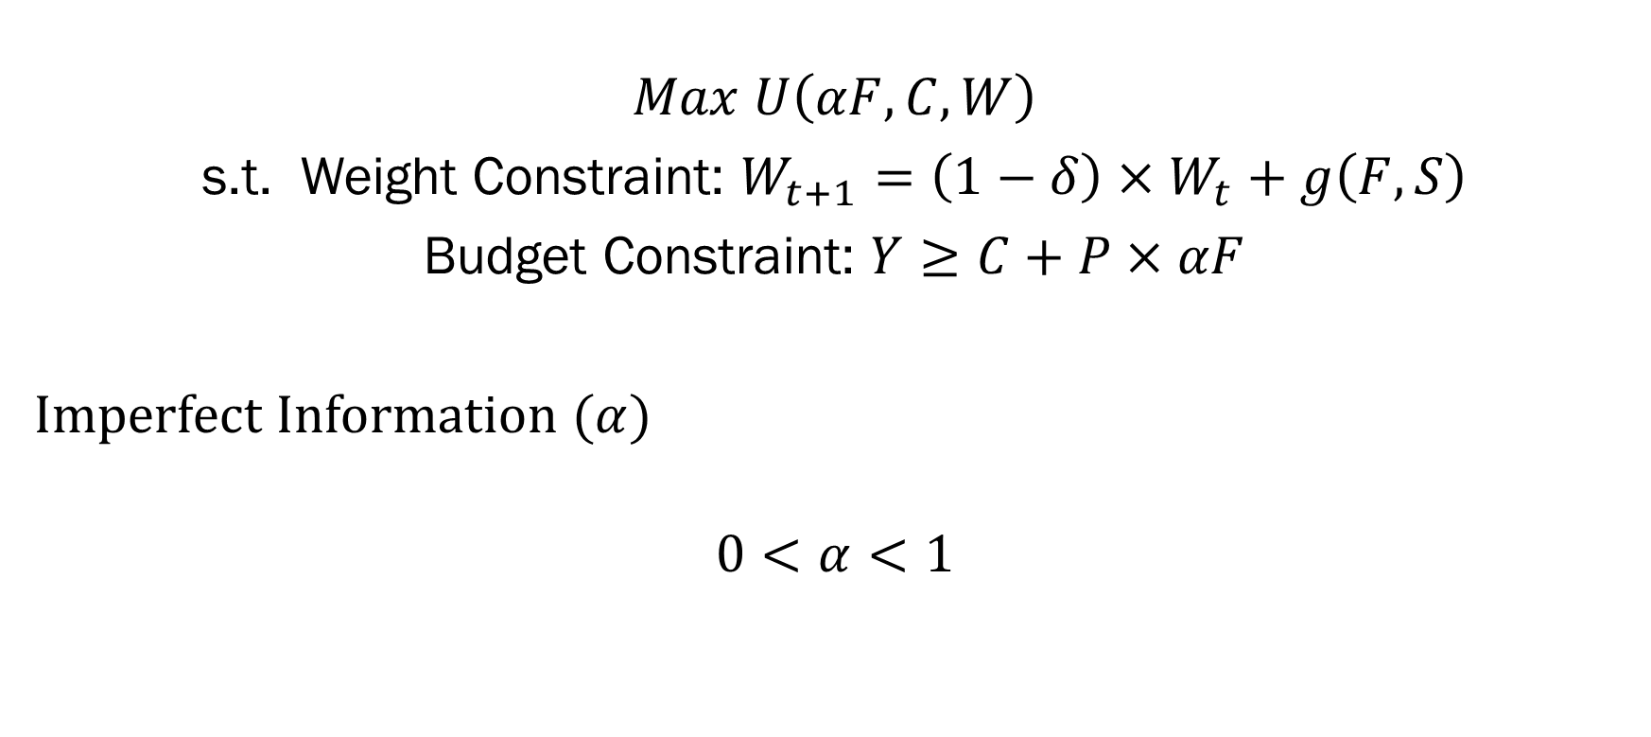

Imperfect Information Contribution ($α$)
$$Max U\left(αF, C, W\right)$$
s.t. Weight Constraint: $W_{t+1}=\left(1−δ\right)×W_{t}+g\left(F,S\right)$
Budget Constraint: $Y≥C+P×αF$
Imperfect Information ($α$)
$$0<α<1$$
Notes:
When $α$ equals 1, perfect information is available for consumers.
When $α$ equals 0, consumers know nothing about the food product.
Model Prediction:
The lack of nutrition information or dietary knowledge causes rational individuals to consume more than what is needed to maintain the ideal weight and end up gaining unnecessary weight.
The imperfect information increases the income effect and price effect on weight as suggested in the original model.

Slide 10

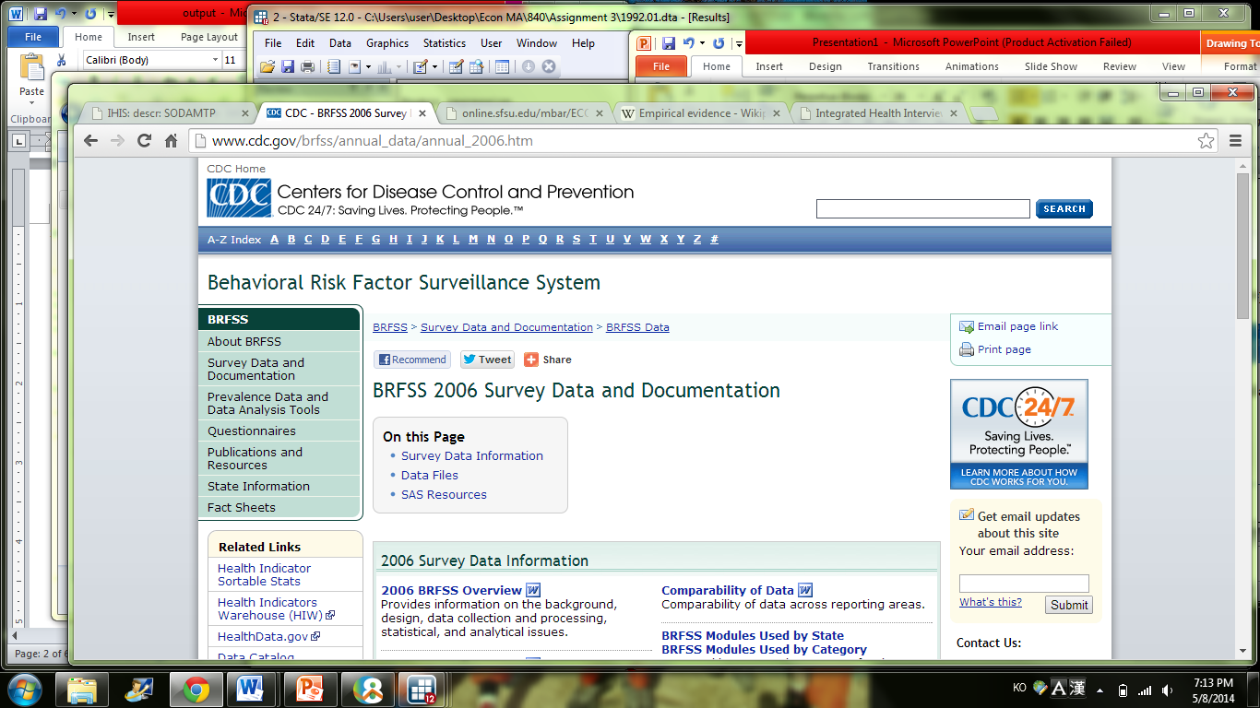
Data Source
National Health Interview Survey (NHIS)
Year = 1991, 1993, 1995, 1998
Independently Pooled Cross Section Data

Slide 11
Statistic Summary

Slide 12
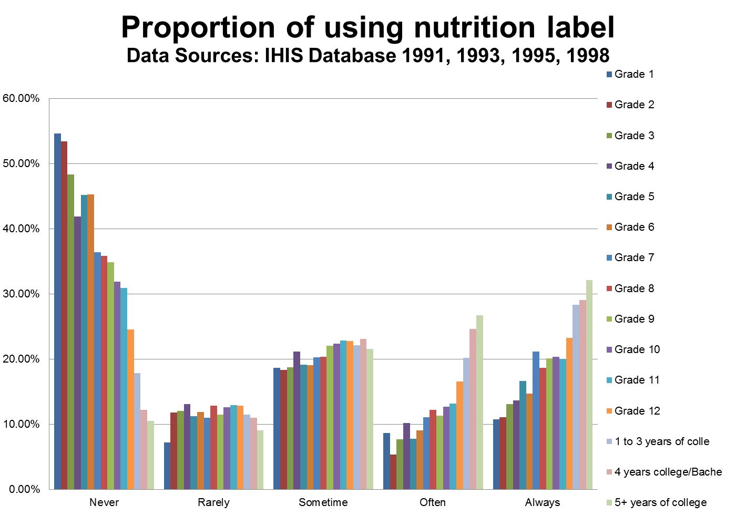
Educational Demographic
Notes:
Higher education attainment population would be more likely to use the nutrition label at the point of purchase.
Lower education attainment population would be less likely to use the nutrition label at the point of purchase.
Since this is a self-reported survey, there is a possibility of self-reported bias.

Slide 13
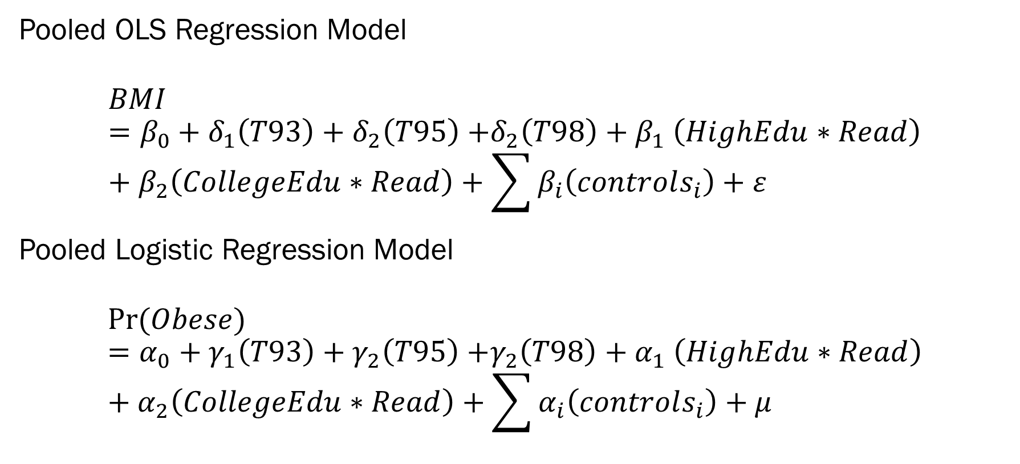
Empirical Model
Pooled OLS Regression Model
$$BMI=β_{0}+δ_{1}\left(T93\right)+δ_{2}\left(T95\right){+δ_{2}\left(T98\right)+β}_{1}\left(HighEdu∗Read\right)+β_{2}\left(CollegeEdu∗Read\right)+\sum{β_{i}\left(controls_{i}\right)}+ε$$
Pooled Logistic Regression Model
$$Pr⁡(Obese)=α_{0}+γ_{1}\left(T93\right)+γ_{2}\left(T95\right){+γ_{2}\left(T98\right)+α}_{1}\left(HighEdu∗Read\right)+α_{2}\left(CollegeEdu∗Read\right)+\sum{α_{i}\left(controls_{i}\right)}+μ$$
Notes:
BMI – Self reported height and weight
Key Variable of Interest:
Interaction between different education group and label reading
Other demographic controls are included in the model

Slide 14
Empirical Result
Notes:
The key variables,
Reading label – significant at 1% level in both models. The positive coefficient is misleading. One possible explanation to the positive sign is that individuals who have higher BMI would be more sensitive on reading the nutrition information to avoid the risk of weight gain.
High School Education & Reading label – failed to be statistically significant in both models, which means the high school graduates did not benefit from reading the nutrition label compare to the base group, which is individuals who did not finish high school education.
College Education & Reading Label – Statistically significant at 1% level in the linear model, but failed to be significant in the logit model. More often the individuals in this education group, lower the BMI will be result.

Slide 15
Empirical Result
Notes:
Almost all coefficients for the interaction terms failed to be statistically significant before the year of 1998.
The coefficient for the college education and reading nutrition label is at least 5% level significant in both the pooled cross section and logit model.

Slide 16
Empirical Result (Different Ethnic Group)
Notes:
Reading label had been statistically significant across years for the white and non-white samples.
The interaction terms failed to be statistically significant in the first three year terms for both white and non-white samples.
The interaction terms are at least 5% statistically significant for the college education and reading label interaction in 1998 for only the white samples.
Non-Hispanic Whites with higher education were adopting the new policy faster than other ethnic groups.
Reason: they are the biggest pre-package food consumer group. Other ethnic groups prepare food more at home and they are more likely to purchase the random weight food, which nutrition label is not required.

Slide 17
Empirical Result (Across BMI Distribution)
Notes:
The effect of label reading and the interaction terms are highly significant in the lower quantile, but fail to be statistically significant in the 0.9 quantile.
Label reading has a greater effect on BMI for individuals with lower BMI, but not benefiting the people at the highest BMI quantile.

Slide 18

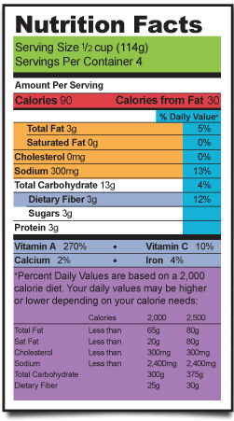
Results
From 1991 - 1998
Some college education
High school or lower education
BMI reduced by 1.09
Notes:
For the beginning 8 years of nutrition labeling law, individuals with college education, who read nutrition label at the point of purchase, on average, have 1.09 BMI compare to the lower education attainment individuals, who never use nutritional label.

Slide 19
Results
1998
Some college education
High school or lower education
BMI reduced by 1.173
Reduce risk of obesity by 31.87%
Notes:
The size of the effect increases to -1.173 in 1998 and reduce the risk of obesity by 31.87%.

Slide 20
Results
1998 (Non-Hispanic White)
Some college education
High school or lower education
BMI reduced by 1.192
Reduce risk of obesity by 35.97%
Notes:
If we only focus on non-Hispanic Whites, the impact is even greater, which would reduce BMI by 1.192 and reduce the risk of obesity by 35.97%.

Slide 21
Policy Implication
Informational policy includes nutritional labeling, menu labeling, health education, and nutrition dietary education.
Informational policy takes time for individuals to adopt.
Consumers’ behavior improves as the level of imperfect information is reduced.
Expanding and promoting culturally sensitive health education programs targeting different ethnic groups will help minorities improve their dietary behavior.

Slide 22
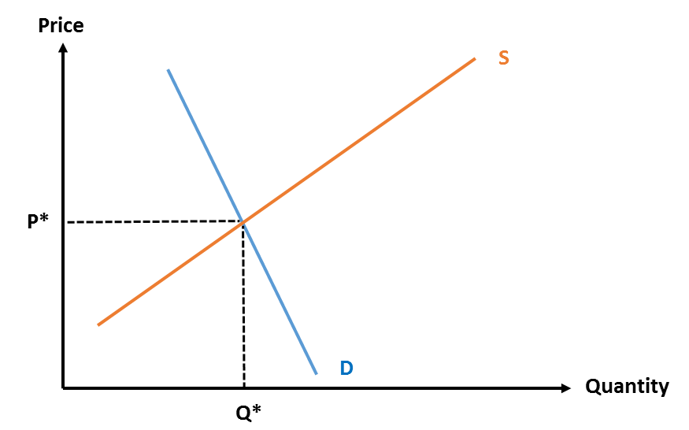
ECON101
Tax Policy may not be as efficient as the informational policy.
It may reduce consumption of certain calorically dense food in the short run.
In the long run, the informational policy can address the obesity epidemic effectively with less burden on consumers.

Slide 23

Thank You! Please email comments to lokman@mail.sfsu.edu

